Slide 1


Slide 2




Welcome!
Introductions
Can everyone access Noteable?
www.cdcs.ed.ac.uk

Slide 3

Week 1:
Writing and running code, Conditions & Logic
www.cdcs.ed.ac.uk

Slide 4
Programming = Telling the computer what to do
You need to speak a language the computer will understand, e.g., Python
www.cdcs.ed.ac.uk

Slide 5
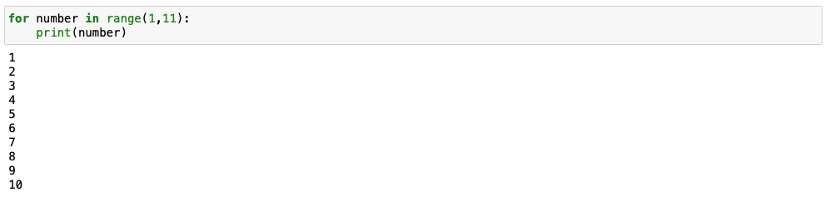
Syntax
Count from 1 to 10.
for number in range(1,11): print(number)
1, 2, 3, 4, 5, 6, 7, 8, 9, 10
🧑‍💻
www.cdcs.ed.ac.uk

Slide 6
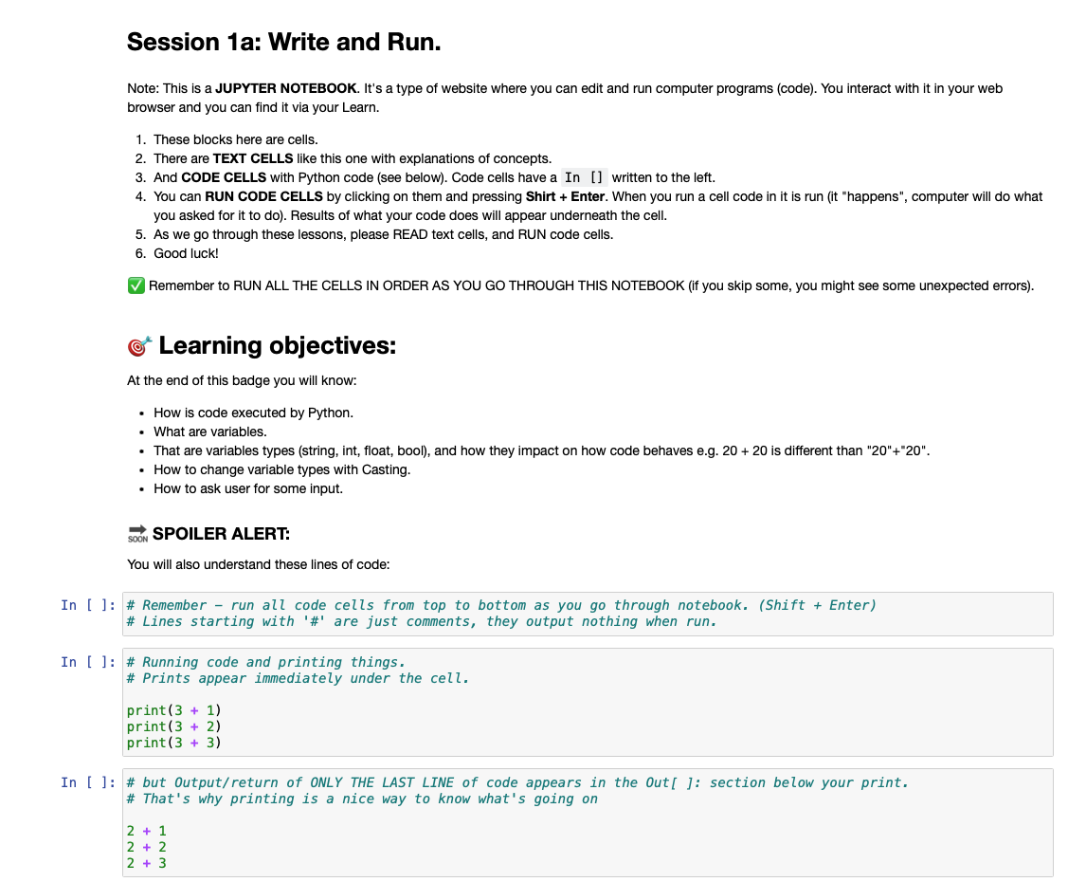
Jupyter Notebooks
Markdown cells
Code cells
www.cdcs.ed.ac.uk

Slide 7
Code is written in lines. Each line does something, and they are executed from top to bottom.
count = 43
print(count)
count = 44
print(count)
www.cdcs.ed.ac.uk

Slide 8

Variables are places to store values for later. There are different types of variables:
string for text, e.g., “banana” or “I like Python”
int (integer) for whole numbers, e.g., 1, 5, 2014
float for decimal numbers, e.g., 2.25, 6.1246, 16.2
bool (Boolean) for logic values: True, False
my_favourite_fruit = “apple”
“apple”
my_favourite_fruit
www.cdcs.ed.ac.uk

Slide 9
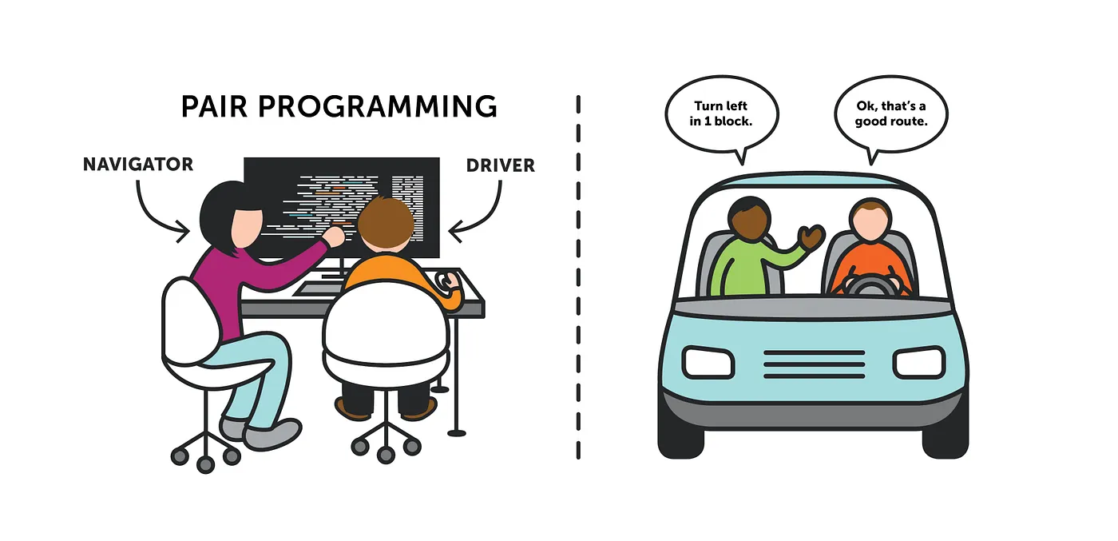
Image from https://medium.com/@tomspencer_uk/pair-programming-and-problem-solving-4531ef3bf171
www.cdcs.ed.ac.uk

Slide 10
Pair Programming
find a partner
switch driver & navigator roles regularly, e.g., after every task in the notebook
you can work with the same partner throughout the course, or switch between sessions
ask us for help! (yes, even for small things)
www.cdcs.ed.ac.uk

Slide 11
Let’s get programming – Notebook 1a
https://noteable.edina.ac.uk/login
→ log in with your student/staff account
→ select Python 3 and start the server
→ click “+GitRepo” (top right) add the GitHub link below, and click “clone”.
https://github.com/DCS-training/IntroToPython_2023
www.cdcs.ed.ac.uk

Slide 12
Comparing Variables
2 < 2
2 < 3
3 > 2
2 <= 2
3 != 2
3 != 3
2 == 2
2 == 3
"apple" == "apple"
"apple" == "orange"
"apple" == "Apple"
”2023" == 2023
True
False
True
False
False
False
False
True
True
True
True
False
www.cdcs.ed.ac.uk

Slide 13
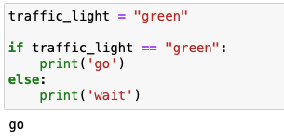
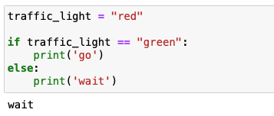
Conditionals
Controlling what part of your code gets executed based on conditions
E.g., “If the traffic light is green, go, otherwise, wait.”
www.cdcs.ed.ac.uk

Slide 14
Let's get programming:
Notebook 1b –
Conditions & Logic
www.cdcs.ed.ac.uk

Slide 15
Week 2:
Using and writing Functions
www.cdcs.ed.ac.uk

Slide 16
Welcome Back!
Whilst you are coming in, open up your web browser and load up Noteable:
https://noteable.edina.ac.uk/login
→ log in with your student/staff account
→ select Python 3 and start the server
→ from last week you should have all the files, if you do not then...
click “+GitRepo” (top right) add the GitHub link below, and click “clone”.
https://github.com/DCS-training/IntroToPython_2023
www.cdcs.ed.ac.uk

Slide 17
Last week...
Write and run,
logic and conditionals.
...this week...
Functions,
and more functions!
www.cdcs.ed.ac.uk

Slide 18
What is a function?
2. Why do we use functions?
3. How do I create a function in Python?
www.cdcs.ed.ac.uk

Slide 19
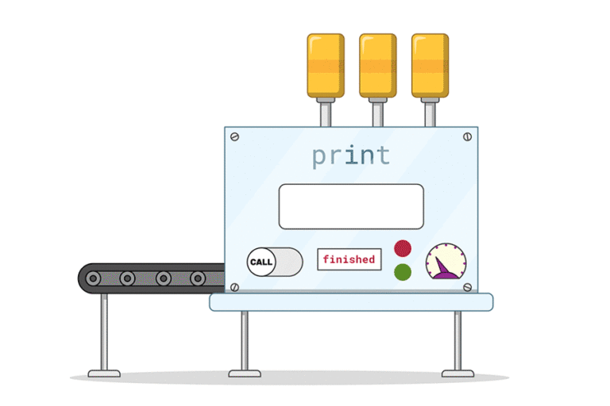
What is a function?
www.cdcs.ed.ac.uk

Slide 20
What is a function?
A way to generalise a process that will need to be done over and over again.
www.cdcs.ed.ac.uk

Slide 21
2. Why do we use functions?
Reduce lines of code,
Enhance computing performance,
Make life easier!
www.cdcs.ed.ac.uk

Slide 22

2. Why do we use functions?
www.cdcs.ed.ac.uk

Slide 23
3. How do I make a function in Python?
'def'
Name
What goes into it (arguments)
What it does (the steps)
What it gives back (return value)
www.cdcs.ed.ac.uk

Slide 24
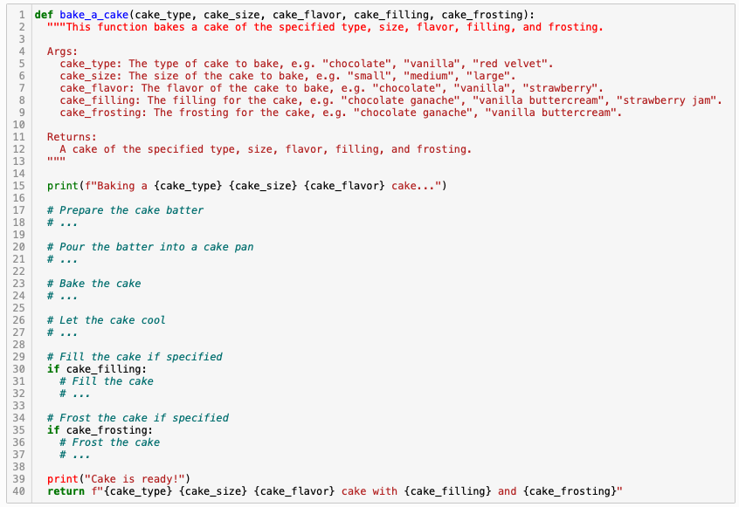
3. How do I make a function in Python?
www.cdcs.ed.ac.uk

Slide 25
Pair Programming – Reminder
work with your partner from last week, or find someone new
switch driver & navigator roles regularly, e.g., after every task in the notebook
ask us for help!
www.cdcs.ed.ac.uk

Slide 26
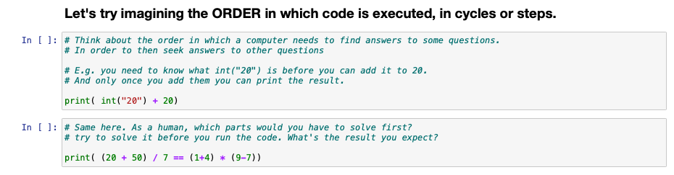
Let's do some programming:
Session 2 –
Functions = superpowers.
www.cdcs.ed.ac.uk

Slide 27
What is scope all about?
www.cdcs.ed.ac.uk

Slide 28


Local:
Only those close to him (within the same function) who know about what he can do.
Global:
Can be accessed by anyone, anywhere – everyone knows what he can do!
www.cdcs.ed.ac.uk

Slide 29
Rule 1: Anything inside a function is mysterious to the outside...
You are not able to peek inside of a function elsewhere in code. Only things returned will become available to the 'global' environment.
Rule 2: Functions can look outside, but shouldn't...
Things can get complicated when a function looks outside. We tackle this by carefully specifying arguments with relevant names.
www.cdcs.ed.ac.uk

Slide 30
Let's keep programming:
Session 2 –
Functions = superpowers.
www.cdcs.ed.ac.uk

Slide 31
Week 3:
Lists and collections
www.cdcs.ed.ac.uk

Slide 32
Recap: Variables
Variables are places to store values for later. There are different types of variables:
string for text, e.g., “banana” or “I like Python”
int (integer) for whole numbers, e.g., 1, 5, 2014
float for decimal numbers, e.g., 2.25, 6.1246, 16.2
bool (Boolean) for logic values: True, False
my_favourite_fruit = “apple”
“apple”
my_favourite_fruit
www.cdcs.ed.ac.uk

Slide 33
Lists
planet0 = "Mercury"
planet1 = "Venus"
planet2 = "Earth"
planet3 = "Mars"
planet4 = "Jupyter"
planet5 = "Saturn"
planet6 = "Uranus”
planets = ["Mercury", "Venus", "Earth", "Mars", "Jupyter", "Saturn", "Uranus"]
www.cdcs.ed.ac.uk

Slide 34
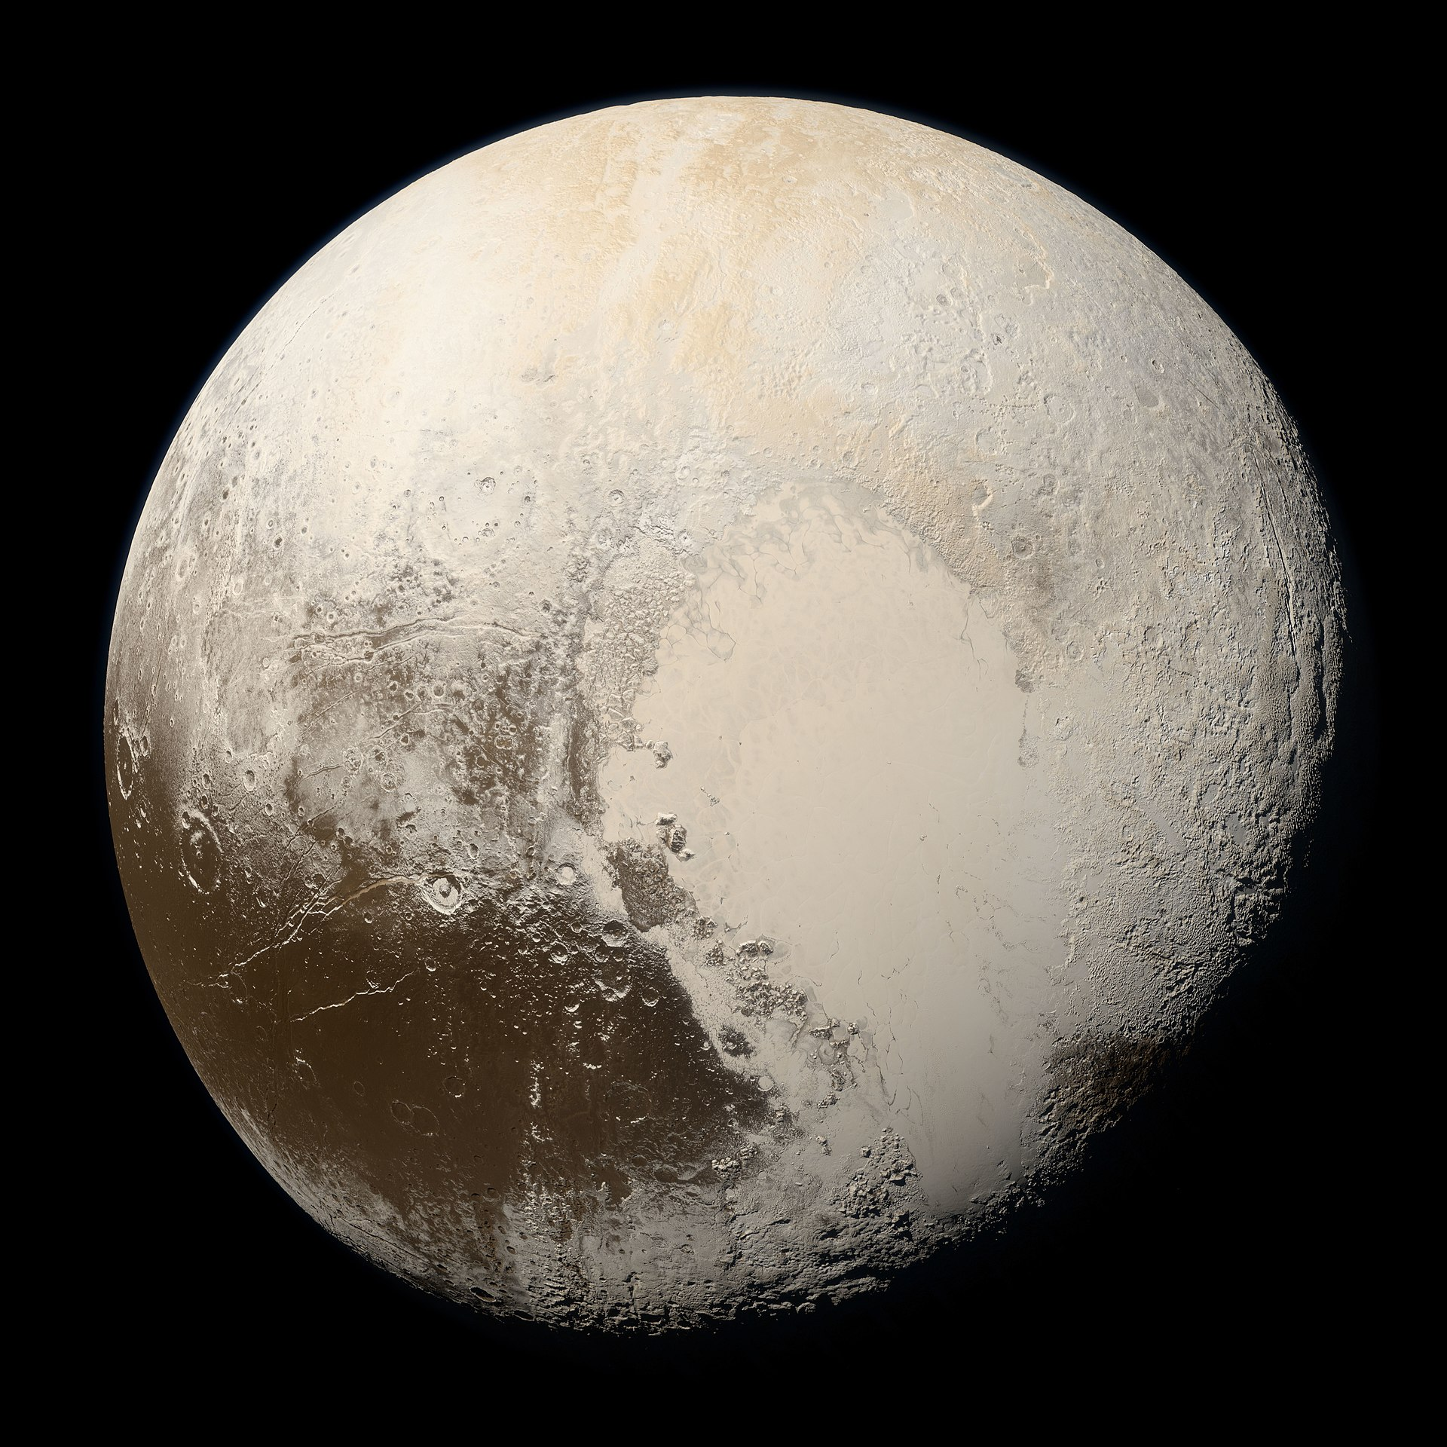
Why use lists?
planets = ["Mercury", "Venus", "Earth", "Mars", "Jupyter", "Saturn", "Uranus"]
✅ Count how many items are in the list
✅ Check if a specific item is in the list
✅ Find the location of a specific item
✅ Add and remove items
✅ Sort (alphabetically or otherwise)
Pluto (not a planet)
www.cdcs.ed.ac.uk

Slide 35
Alternatives to lists
Tuple
planets = ("Mercury", "Venus", "Earth", "Mars", "Jupyter", "Saturn", "Uranus”)
Uses () instead of []
Same as a list, except it cannot be changed after creating it
Set
planets = {"Mercury", "Venus", "Earth", "Mars", "Jupyter", "Saturn", "Uranus”}
Uses {} instead of [] (list) or () (tuple)
Same as a list, except:
Every item is unique (items cannot be listed twice)
Order does not matter and will change (no indexing)
www.cdcs.ed.ac.uk

Slide 36
Dictionaries
Used to store multiple pieces of information about one thing
Uses key-value pairs: each piece of data (value) has a label (key)
mercury = {“name”: “Mercury”, “day_length”: 59, “hottest_temp”: 430}
Combining lists and dictionaries is useful for real-world data: We often have multiple pieces of information about lots of different things and want to work with all of it at the same time!
planets = [ {“name”: “Mercury”, “day_length”: 59, “hottest_temp”: 430},
{“name”: “Venus”, “day_length”: 243.025, “hottest_temp”: 462},
{“name”: “Earth”, “day_length”: 1, “hottest_temp”: 56.7},
…
]
www.cdcs.ed.ac.uk

Slide 37
Pair Programming – Reminder
work with your partner from last week, or find someone new
switch driver & navigator roles regularly, e.g., after every task in the notebook
ask us for help!
www.cdcs.ed.ac.uk

Slide 38
Let's get programming:
Session 3a –
Collections
www.cdcs.ed.ac.uk

Slide 39
What are list comprehensions?
www.cdcs.ed.ac.uk

Slide 40
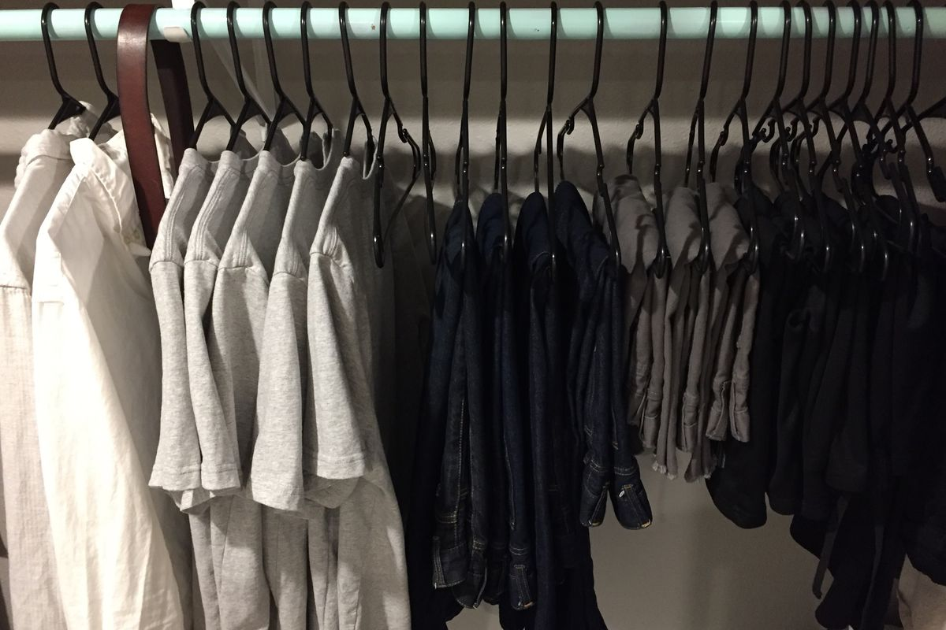
www.cdcs.ed.ac.uk

Slide 41
How do I get someone to pick the shirts from the wardrobe?
Say that it is the shirts you want,
For each item of clothing, check if it is a shirt,
If it’s a shirt, then take it out the wardrobe.
www.cdcs.ed.ac.uk

Slide 42
shirts = [
item_of_clothing
for item in wardrobe:
if item == shirt
]
www.cdcs.ed.ac.uk

Slide 43
initial_list = [thing1, thing2, …]
variable_name = [
<thing to get new list of>
for item in initial_list:
if item ==/>/< <some condition>
]
www.cdcs.ed.ac.uk

Slide 44
How do I get someone to pick the shirts from the wardrobe?
Say that it is the shirts you want,
For each item of clothing, check if it is a shirt,
If it’s a shirt, then take it out the wardrobe.
www.cdcs.ed.ac.uk

Slide 45
Some maths functions that may come in handy...
www.cdcs.ed.ac.uk

Slide 46
max( ) / min() Get the largest/smallest element in a group. For letters it will mean 'highest/lowest in the alphabet'.
len( ) Size of the collection, can be used on lists, dicts, but also on strings.
sum( ) Combine all elements. Just used for numbers.
www.cdcs.ed.ac.uk

Slide 47
Let's keep programming:
Session 3b –
List Comprehensions
www.cdcs.ed.ac.uk

Slide 48
Finishing up...
How to import data
Additional resources
Feedback for us
www.cdcs.ed.ac.uk

Slide 49
How to import data
To import data there is a range of methods, the easiest is using the package 'pandas'
Eg.
import pandas as pd
data_frame = pd.read_csv("<Your File Pathway>")
www.cdcs.ed.ac.uk

Slide 50
Additional Resources
This course used (slightly modified) notebooks from Code Storytelling (http://www.codestorytelling.com). We covered badges 1,2,4,5,7, and 8. Consider working through some more of the notebooks and watching some of the videos.
Think Python is an introductory Python book with many exercises, free to read online: https://greenteapress.com/wp/think-python-2e/
www.cdcs.ed.ac.uk

Slide 51
Feedback for us...
We hope you've enjoyed the course as much as we did.
It is really useful for us to hear your feedback
https://forms.office.com/r/YYNrqvuNr8
Should be really quick and only take 5 mins (maximum!)
www.cdcs.ed.ac.uk

Slide 52
Thank you from us!
Python
Introduction to Data Analysis in Python (26/11-03/12/2024, with Aislinn Keogh)
Silent Disco: Facial Recognition in Historical Photographs with Artificial Intelligence in Python (23/09/2024, 14:00–16:00, with Martin Disley)
Other
Build Your Personal or Project Website with GitHub Pages (4-11/11/2024, with Sarah Schöttler & Aislinn Keogh)
www.cdcs.ed.ac.uk

